Slide 1
Objectives
Knowledge:
What is a String?
What is an index in a String?
Skills:
Given documentation for functions that can be called on a String, identify the parts including: name, parameters, return type.
Given documentation for String functions and a program that calls those functions, trace the code to predict the output of the program.

Slide 2
A string is...
A sequence of characters!

Slide 3
Examples of Strings!
(define school “AFSE”)
(define celeb “Justin Bieber”)
(define ipAddress “113.186.14.10”)
(define emoji “(╯°□°）╯︵ ┻━┻)”)

Slide 4
Indices & Length
(define name “Simon Petrikov”)

Slide 5
Indices & Length
(define name “Simon Petrikov”)
0 1 2 3 4 5 6 7 8 9 10 11 12 13
indices!

Slide 6
Indices & Length
(define name “Simon Petrikov”)
(define my-char (string-ith name 4))
my-char
0 1 2 3 4 5 6 7 8 9 10 11 12 13
indices!

Slide 7
Indices & Length
(define name “Simon Petrikov”)
(define name-letters (string-length name))
name-letters
14
length!

Slide 8
Indices & Length
(define name “Simon Petrikov”)
(define mid (/ (string-length name) 2))
(string-ith name mid)
(string-ith name (- mid 2))

Slide 9
Contenation
(define prefix “hello”)
(define suffix “world”)
(define HW (string-append prefix “a” suffix))
HW

Slide 10
(define name “Simon Petrikov”)
(define part (substring name 1 9))
part

Slide 11
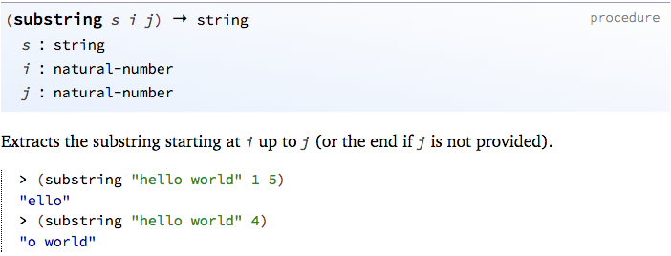
String name = “Simon Petrikov”;
String part = name.substring(1, 9);
System.out.println(part);

Slide 12
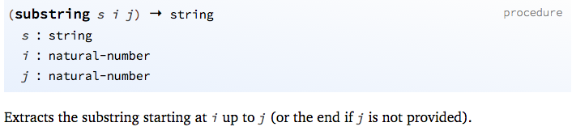
(define name “Simon Petrikov”)
(define part (substring name 1 9))
part
0 1 2 3 4 5 6 7 8 9 10 11 12 13
beginIndex
endIndex

Slide 13
Practice
Add the following two lines to the definitions area:
Then use string primitives to create an expression that concatenates prefix and suffix and adds "_" between them. When you run this program, you will see "hello_world" in the interactions area.
(define prefix "hello")
(define suffix "world")

Slide 14
Documentation (memorize)
http://docs.racket-lang.org/ htdp-langs/
beginner.html

Slide 15
Review String operators you will need
string-append concatenates two or more given strings into one;
string-length consumes a string and produces a (natural) number;
string-ith consumes a string s together with a natural number i and then extracts the 1String located at the ith position (counting from 0);
number->string consumes a number and produces a string;
substring consumes a string and one or two numbers and produces a part of the string

